Slide 1
Hemingway’s “Best Work”
For Sale: baby shoes, never worn.
Ernest Hemingway

Slide 2
College was fun.
Damn student loans.
-Randy Boland
Says deaf boyfriend:
you’re too quiet.
-Anna Jane Grossman

Slide 3
Followed white rabbit.
Became black sheep.
-Gabrielle Maconi
Soul’d out so I could prophet.
-Gotham Chopra, Deepak Chopra’s son

Slide 4
Happiest when ignoring
huge financial debt.
-Ayanna Bryan
Xenophile escapist tumbleweed
globetrots, finds self.
-Dominic Arizona Bonuccelli
Blogging is easy.
Writing is hard.
-Jennifer Shreve

Slide 5
Dabbler in much, expert in none. – Joan Cady
I lost god. I found myself.
-Joe Kimmel
Born abroad.
Came here.
Lost culture.
-Kris Chelminski
Still on road less traveled.
-Joe Quesada

Slide 6
Atheist alcoholic gets
Sober through God.
-Bob Todd
Discovered moral code
Via Judy Blume.
-Beth Greivel
Glass half full;
pockets half empty.
-Marina Guthrie
No wife.
No kids.
No problems.
-Rip Ripley
It’s pretty high. You go first.
-Alan Eagle

Slide 7
One tooth,
one cavity,
life’s cruel.
-John Bettencourt
My first concert: Zappa. Explains everything.
-Janet Tashjian
Scarred by 9/11;
helped by penguins.
-Audrey Blackburn

Slide 8
Mormon economist marries feminist. Worlds collide.
-Michael McBride
Mormon feminist loves husband, hates patriarchy.
-Carolina Kline

Slide 9
Students laughed appreciatively. The professor relaxed.
-Laurie Hensley
Tequila.
Amnesia.
Coincidence?
I think not.
-Larry Caraviello
I was the only planned sibling.
-Mary Sebas

Slide 10
Mixed blood.
I am America’s future.
-Holly Santiago
Without me, it is
Just aweso.
-Chris Madigan
Not quite what I was planning…
-Summer Grimes

Slide 11
I came, I saw, I concurred.
-Cris Antisirhc
Failed SAT. Lost scholarship. Invented rocket. - William Shatner
Gown removed carelessly. Head, less so. - Joss Whedon

Slide 12
Machine. Unexpectedly, I’d invented a time - Alan Moore
Internet “wakes up?” Ridicu - no carrier. - Charles Stross
With bloody hands, I say good-bye. - Frank Miller

Slide 13
“Cellar?” “Gate to, uh … hell, actually.” - Ronald D. Moore
Epitaph: Foolish humans, never escaped Earth. - Vernor Vinge
We kissed. She melted. Mop please! - James Patrick Kelly

Slide 14
The baby’s blood type? Human, mostly. - Orson Scott Card
TIME MACHINE REACHES FUTURE!!! … nobody there … - Harry Harrison
Easy. Just touch the match to - Ursula K. Le Guin
Tick tock tick tock tick tick. - Neal Stephenson

Slide 15
God to Earth: “Cry more, noobs!” - Marc Laidlaw
whorl. Help! I'm caught in a time - Darren Aronofsky and Ari Handel
Bush told the truth. Hell froze. - William Gibson

Slide 16
Leia: "Baby's yours." Luke: "Bad news…" - Steven Meretzky
He read his obituary with confusion. - Steven Meretzky
Clones demand rights: second Emancipation Proclamation. - Paul Di Filippo
Will this do (lazy writer asked)? - Ken MacLeod

Slide 19
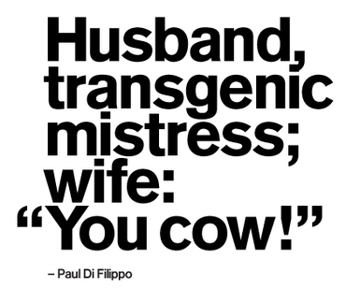
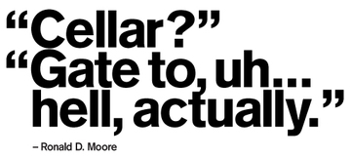

Slide 20
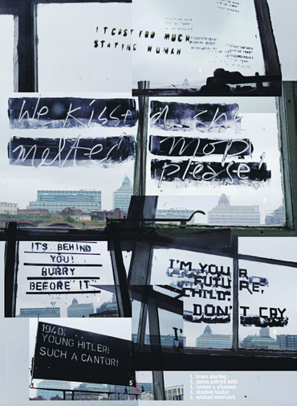

Slide 21
College was fun.
Damn student loans.
-Randy Boland
Says deaf boyfriend:
you’re too quiet.
-Anna Jane Grossman

Slide 22
Followed white rabbit.
Became black sheep.
-Gabrielle Maconi
Soul’d out so I could prophet.
-Gotham Chopra, Deepak Chopra’s son

Slide 23
Happiest when ignoring
huge financial debt.
-Ayanna Bryan
Xenophile escapist tumbleweed
globetrots, finds self.
-Dominic Arizona Bonuccelli
Blogging is easy.
Writing is hard.
-Jennifer Shreve

Slide 24
Dabbler in much, expert in none. – Joan Cady
I lost god. I found myself.
-Joe Kimmel
Born abroad.
Came here.
Lost culture.
-Kris Chelminski
Still on road less traveled.
-Joe Quesada

Slide 25
Atheist alcoholic gets
Sober through God.
-Bob Todd
Discovered moral code
Via Judy Blume.
-Beth Greivel
Glass half full;
pockets half empty.
-Marina Guthrie
No wife.
No kids.
No problems.
-Rip Ripley
It’s pretty high. You go first.
-Alan Eagle

Slide 26
One tooth,
one cavity,
life’s cruel.
-John Bettencourt
My first concert: Zappa. Explains everything.
-Janet Tashjian
Scarred by 9/11;
helped by penguins.
-Audrey Blackburn

Slide 27
Mormon economist marries feminist. Worlds collide.
-Michael McBride
Mormon feminist loves husband, hates patriarchy.
-Carolina Kline

Slide 28
Students laughed appreciatively. The professor relaxed.
-Laurie Hensley
Tequila.
Amnesia.
Coincidence?
I think not.
-Larry Caraviello
I was the only planned sibling.
-Mary Sebas

Slide 29
Mixed blood.
I am America’s future.
-Holly Santiago
Without me, it is
Just aweso.
-Chris Madigan
Not quite what I was planning…
-Summer Grimes

Slide 30
I came, I saw, I concurred.
-Cris Antisirhc
Failed SAT. Lost scholarship. Invented rocket. - William Shatner
Gown removed carelessly. Head, less so. - Joss Whedon

Slide 31
Machine. Unexpectedly, I’d invented a time - Alan Moore
Internet “wakes up?” Ridicu - no carrier. - Charles Stross
With bloody hands, I say good-bye. - Frank Miller

Slide 32
“Cellar?” “Gate to, uh … hell, actually.” - Ronald D. Moore
Epitaph: Foolish humans, never escaped Earth. - Vernor Vinge
We kissed. She melted. Mop please! - James Patrick Kelly

Slide 33
The baby’s blood type? Human, mostly. - Orson Scott Card
TIME MACHINE REACHES FUTURE!!! … nobody there … - Harry Harrison
Easy. Just touch the match to - Ursula K. Le Guin
Tick tock tick tock tick tick. - Neal Stephenson

Slide 34
God to Earth: “Cry more, noobs!” - Marc Laidlaw
whorl. Help! I'm caught in a time - Darren Aronofsky and Ari Handel
Bush told the truth. Hell froze. - William Gibson

Slide 35
Leia: "Baby's yours." Luke: "Bad news…" - Steven Meretzky
He read his obituary with confusion. - Steven Meretzky
Clones demand rights: second Emancipation Proclamation. - Paul Di Filippo
Will this do (lazy writer asked)? - Ken MacLeod

